Slide 1
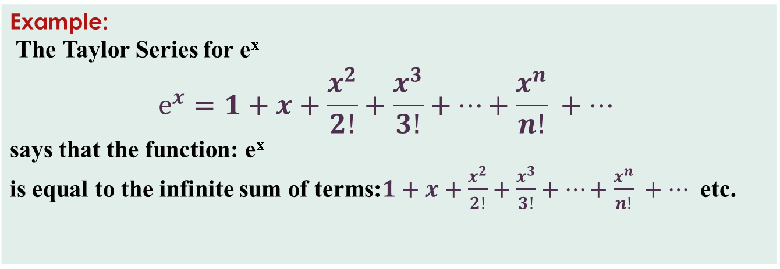
Taylor Series
=> A Taylor Series is an expansion of some function into an infinite sum of terms, where each term has a larger exponent like x, x², x³, etc.
=> Does it really work?
Example: The Taylor Series for e^{x} $$e^{x}=1+x+\frac{x^{2}}{2!}+\frac{x^{3}}{3!}+…+\frac{x^{n}}{n!} +…$$ says that the function: e^{x} is equal to the infinite sum of terms:$1+x+\frac{x^{2}}{2!}+\frac{x^{3}}{3!}+…+\frac{x^{n}}{n!} +…$ etc.

Slide 2


Let’s try it:
Terms | Result
1+2 | 3
$$1+2+\frac{2^{2}}{2!}$$ | 5
$$1+2+\frac{2^{2}}{2!}+\frac{2^{3}}{3!}$$ | 6.3333...
$$1+2+\frac{2^{2}}{2!}+\frac{2^{3}}{3!}+\frac{2^{4}}{4!}$$ | 7
$$1+2+\frac{2^{2}}{2!}+\frac{2^{3}}{3!}+\frac{2^{4}}{4!}+\frac{2^{5}}{5!}$$ | 7.2666...
$$1+2+\frac{2^{2}}{2!}+\frac{2^{3}}{3!}+\frac{2^{4}}{4!}+\frac{2^{5}}{5!}+\frac{2^{6}}{6!}$$ | 7.3555...
$$1+2+\frac{2^{2}}{2!}+\frac{2^{3}}{3!}+\frac{2^{4}}{4!}+\frac{2^{5}}{5!}+\frac{2^{6}}{6!}+\frac{2^{7}}{7!}$$ | 7.3809...
$$1+2+\frac{2^{2}}{2!}+\frac{2^{3}}{3!}+\frac{2^{4}}{4!}+\frac{2^{5}}{5!}+\frac{2^{6}}{6!}+\frac{2^{7}}{7!}+\frac{2^{8}}{8!}$$ | 7.3873..
Example: e^{x} for x=2
Well, we already know the answer
is e² = 2.71828... × 2.71828... = 7.389056...
But let's try more and more
terms of our infinite series:
$e^{x}=1+x+\frac{x^{2}}{2!}+\frac{x^{3}}{3!}+…$
It starts out really badly,
but it then gets better and better!

Slide 3
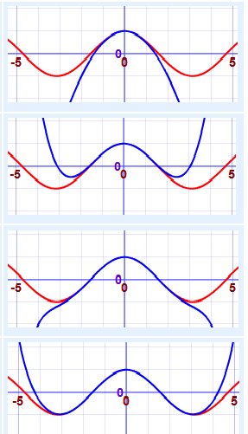
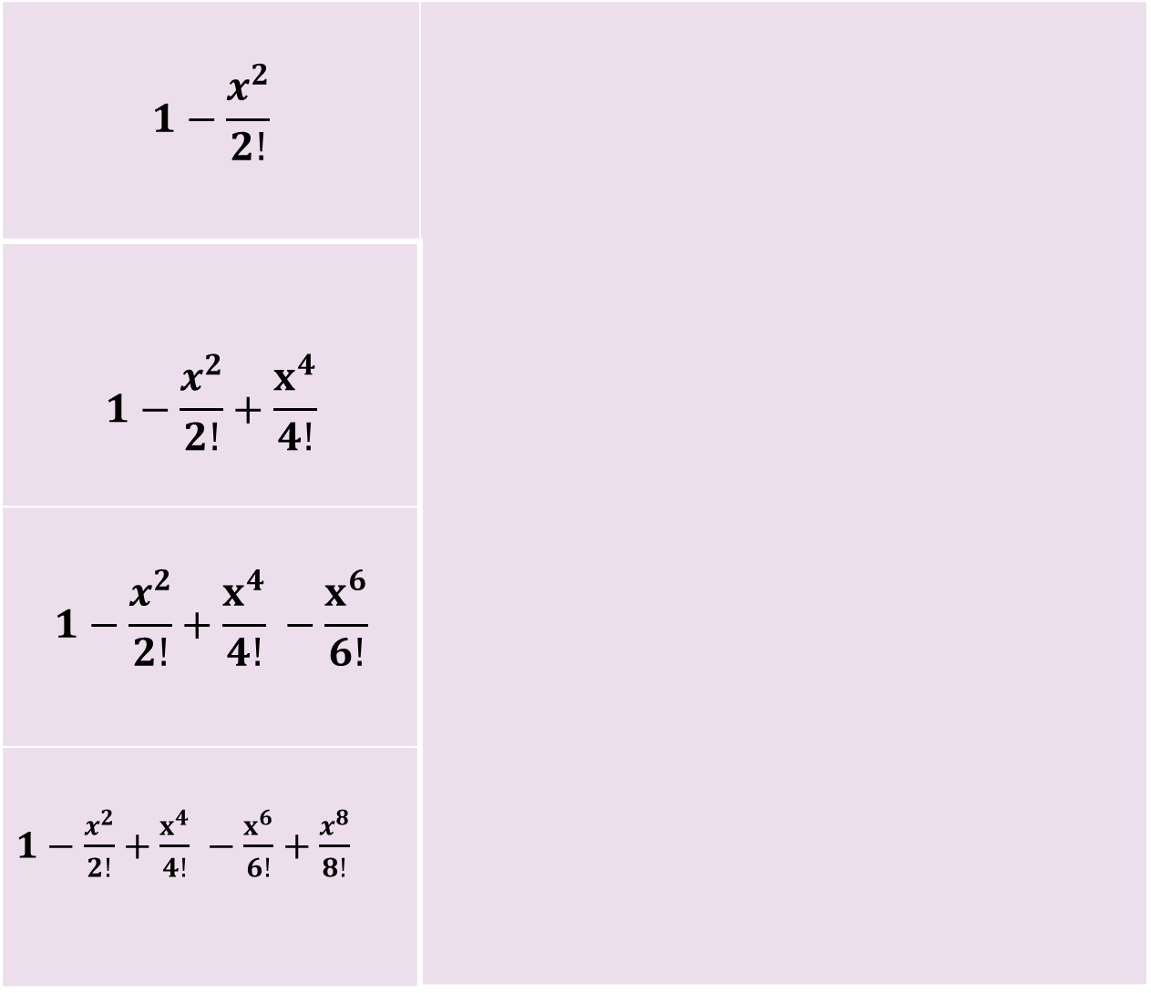

Approximations
$$1−\frac{x^{2}}{2!}$$
$$1−\frac{x^{2}}{2!}+\frac{x^{4}}{4!}$$
$$1−\frac{x^{2}}{2!}+\frac{x^{4}}{4!} −\frac{x^{6}}{6!}$$
$1−\frac{x^{2}}{2!}+\frac{x^{4}}{4!} −\frac{x^{6}}{6!}+\frac{x^{8}}{8!}$
We can use the first few terms of a
Taylor Series to get an approximate
value for a function.
Here we show better and better
approximations for cos(x). The red
line is cos(x), the blue is the
Approximation
$\cos{x}=1−\frac{x^{2}}{2!}+\frac{x^{4}}{4!}−\frac{x^{6}}{6!}+…$

Slide 4

Taylor and Maclaurin Series
Taylor Series:
Any function of x i.e f(x) can be expressed in ascending powers of x, where f(x) and its successive derivatives are finite.
$$f\left(x\right)=f\left(a\right)+\left(x−a\right)f^{′}\left(a\right)+\frac{{\left(x−a\right)}^{2}}{2!}f\text{′′(}\text{a}\text{)+}\frac{{(x−a )}^{\text{3}}}{\text{3}\text{!}}\text{f}\text{′′′}\left(a\right)+…+\frac{{\left(x−a\right)}^{n}}{n!}f^{n}\left(a\right)+…$$
Let’s plug $a=0$ in above series.
Maclaurin Series:
Any function of x i.e f(x) can be expressed in ascending powers of x, where f(x) and its successive derivatives are finite.
$$f\left(x\right)=f\left(0\right)+xf^{′}\left(0\right)+\frac{x^{2}}{2!}f′′{\text{(0}\text{)+}\frac{x^{3}}{3!}f′′}^{′}\left(0\right)+…+\frac{x^{n}}{n!} f^{n}\left(0\right)+…$$

Slide 5

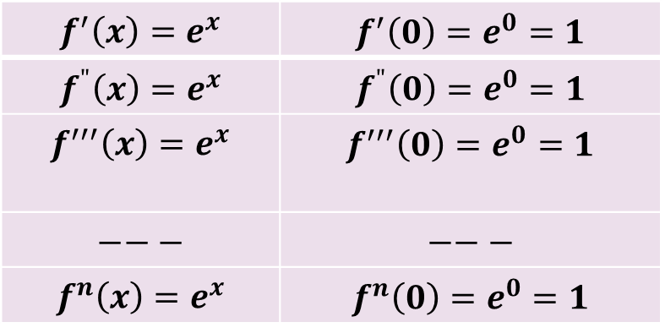
Some Standard function
$f\left(x\right)=e^{x}$
To get the series for $e^{x}$.
Lets use Maclurin’s Series $f\left(x\right)=f\left(0\right)+xf^{′}\left(0\right)+\frac{x^{2}}{2!}f′′{\text{(0)+}\frac{x^{3}}{3!}f′′}^{′}\left(0\right)+…+\frac{x^{n}}{n!} f^{n}\left(0\right)+…$
so we have to find $f\left(0\right),f^{′}\left(0\right), f"(0), … ,f^{n}(0)$.
Here $f\left(x\right)=e^{x}$ => $f\left(0\right)=$> $e^{0}=1$ => $f\left(0\right)=1$
There fore $e^{x}=1+x+\frac{x^{2}}{2!}+\frac{x^{3}}{3!}+…+\frac{x^{n}}{n!} +…$
Note: $f\left(x\right)=e^{−x}$ just replace x by –x in above series to get series for $e^{−x}$
$e^{−x}=1−x+\frac{x^{2}}{2!}−\frac{x^{3}}{3!}+\frac{x^{4}}{4!}−\frac{x^{5}}{5!}+…$
$$f^{′}\left(x\right)=e^{x}$$ | $$f^{′}\left(0\right)=e^{0}=1$$
$$f^{"}\left(x\right)=e^{x}$$ | $$f^{"}\left(0\right)=e^{0}=1$$
$$f^{′′′}\left(x\right)=e^{x}$$ | $$f^{′′′}\left(0\right)=e^{0}=1$$
$$−−−$$ | $$−−−$$
$$f^{n}\left(x\right)=e^{x}$$ | $$f^{n}\left(0\right)=e^{0}=1$$

Slide 6

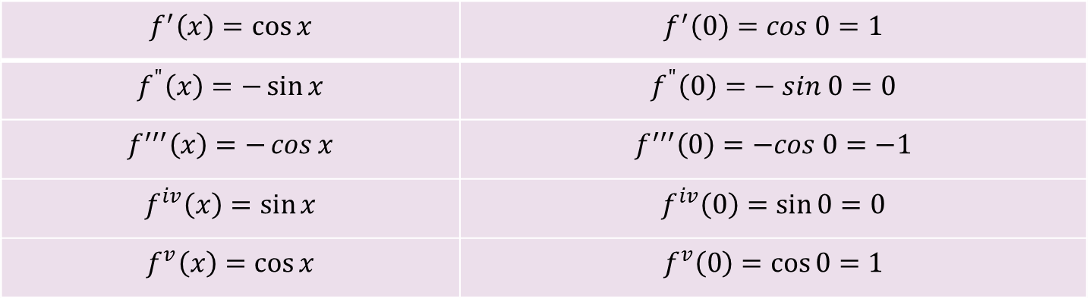
Some Standard function
2. $f\left(x\right)=\sin{x}$
To get the series for $\sin{x}$.
Lets use Maclurin’s Series $f\left(x\right)=f\left(0\right)+xf^{′}\left(0\right)+\frac{x^{2}}{2!}f′′{\text{(0)+}\frac{x^{3}}{3!}f′′}^{′}\left(0\right)+…$
so we have to find $f\left(0\right),f^{′}\left(0\right), f"(0), … ,f^{n}(0)$.
Here $f\left(x\right)=\sin{x}$ => $f\left(0\right)=\sin{0}$ => $f\left(0\right)=0$
There fore $f\left(x\right)=x\text{−}\frac{{\text{x}}^{\text{3}}}{\text{3!}}+\frac{{\text{x}}^{\text{5}}}{\text{5}\text{!}}\text{−}\frac{{\text{x}}^{\text{7}}}{\text{7}\text{!}}+…$
$$f^{′}\left(x\right)=\cos{x}$$ | $$f^{′}\left(0\right)=cos 0=1$$
$$f^{"}\left(x\right)=−\sin{x}$$ | $$f^{"}\left(0\right)=− sin 0=0$$
$$f^{′′′}\left(x\right)=−\cos{x}$$ | $$f^{′′′}\left(0\right)=−cos 0=−1$$
$$f^{iv}\left(x\right)=\sin{x}$$ | $$f^{iv}\left(0\right)=\sin{0}=0$$
$$f^{v}\left(x\right)=\cos{x}$$ | $$f^{v}\left(0\right)=\cos{0}=1$$

Slide 7

$f\left(x\right)=\cos{x}$
$\cos{x}=1−\frac{x^{2}}{2!}+\frac{x^{4}}{4!}−\frac{x^{6}}{6!}+…$
$f\left(x\right)=\tan{x}$
$\tan{x}=x\text{+}\frac{{\text{x}}^{\text{3}}}{\text{3}}+\frac{2x^{5}}{15}+\frac{17x^{7}}{315}+…$
$f\left(x\right)=\sinh{x}$
$f\left(x\right)=\frac{e^{x}−e^{−x}}{2}$ {by definition $\sinh{x}=\frac{e^{x}−e^{−x}}{2}$}
There fore $f\left(x\right)=\frac{1}{2}$[ $Series of \left(e^{x}\right)−Series of e^{−x}$]
$\sinh{x}=x\text{+}\frac{{\text{x}}^{\text{3}}}{\text{3!}}+\frac{{\text{x}}^{\text{5}}}{\text{5!}}\text{+}\frac{{\text{x}}^{\text{7}}}{\text{7!}}+…$
$f\left(x\right)=\cosh{x}$
$\cosh{x}=1+\frac{x^{2}}{2!}+\frac{x^{4}}{4!}+\frac{x^{6}}{6!}+…$ {by definition $\cosh{x}=\frac{e^{x}+e^{−x}}{2}$}
7. $f\left(x\right)=\tanh{x}$
$\tanh{x}=x\text{−}\frac{{\text{x}}^{\text{3}}}{\text{3}}+\frac{2x^{5}}{15}−\frac{17x^{7}}{315}+…$ {by definition $\tanh{x}=\frac{e^{x}−e^{−x}}{e^{x}+e^{−x}}$}

Slide 8

8. $f\left(x\right)=log⁡(1+x)$
$log(1+x)=x−\frac{x^{2}}{2}+\frac{x^{3}}{3}−\frac{x^{4}}{4}+\frac{x^{5}}{5}−…$
9. $f\left(x\right)=log⁡(1−x)$
$log(1−x)=−x−\frac{x^{2}}{2}−\frac{x^{3}}{3}−\frac{x^{4}}{4}−\frac{x^{5}}{5}−…$
10. $f\left(x\right)={\left(1+x\right)}^{n}$
${\left(1+x\right)}^{n}=1+nx+\frac{n\left(n−1\right)}{2!}x^{2}+\frac{n\left(n−1\right)(n−2)}{3!}x^{3}+…$
11. $f\left(x\right)=\frac{1}{(1+x)}$
$\frac{1}{1+x}=1−x+x^{2}−x^{3}+x^{4}−…$
12. $f\left(x\right)=\frac{1}{(1−x)}$
$\frac{1}{1−x}=1+x+x^{2}+x^{3}+x^{4}+…$

Slide 9
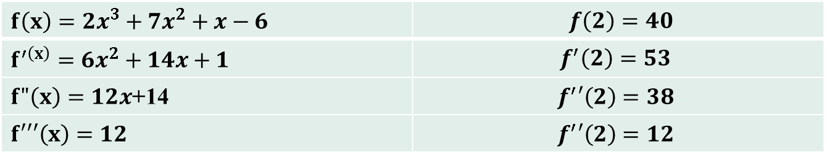

Problems on Taylor Series
Q.1 Expand $2x^{3}+7x^{2}+x−6$ in the powers of (x-2).
Here $f\left(x\right)=2x^{3}+7x^{2}+x−6$ and $x−a=x−2$ => $a=2$
And since we are supposed to expand in powers of (x-2), we have to use Taylors series.
By the Taylors $Th^{m}$ $f\left(x\right)=f\left(2\right)+\left(x−2\right)f^{′}\left(2\right)+\frac{{\left(x−2\right)}^{2}}{2!}f^{"}\left(2\right)+\frac{{\left(x−2\right)}^{3}}{3!}f^{′′′}\left(2\right)$.
So we have to just find $f\left(2\right), f^{′}\left(2\right), f"(2)$ and $f′′′(2)$ and plug into above series.
Lets find that in table.
Therefore the answer is
$f\left(x\right)=40+53\left(x−2\right)+38\frac{{\left(x−2\right)}^{2}}{2!}+12\frac{{\left(x−2\right)}^{3}}{3!}$
=> $f\left(x\right)=40+53\left(x−2\right)+19{\left(x−2\right)}^{2}+2{\left(x−2\right)}^{3}$ is required answer.
$f\left(x\right)=2x^{3}+7x^{2}+x−6$ | $f\left(2\right)=40$
$f^{′\left(x\right)}=6x^{2}+14x+1$ | $$f^{′}\left(2\right)=53$$
$f"\left(x\right)=12x$+14 | $$f^{′}′\left(2\right)=38$$
$f′′′\left(x\right)=12$ | $$f^{′}′\left(2\right)=12$$

Slide 10
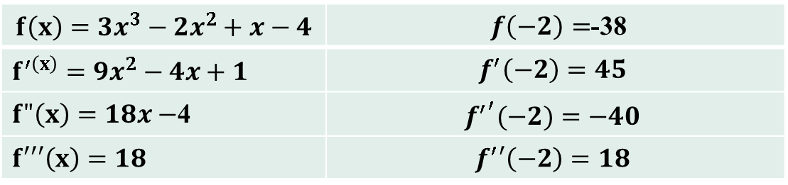

Problems on Taylor Series
Q.2 Expand $3x^{3}−2x^{2}+x−4$ in the power of (x+2), by using Taylors Theorem.
Here $f\left(x\right)=3x^{3}−2x^{2}+x−4$, and $x−a=x+2$ => $a=−2$
And since we are supposed to expand in powers of (x+2), we have to use Taylors series.
By the Taylors $Th^{m}$ $f\left(x\right)=f\left(−2\right)+\left(x+2\right)f^{′}\left(−2\right)+\frac{{\left(x+2\right)}^{2}}{2!}f^{"}\left(−2\right)+\frac{{\left(x+2\right)}^{3}}{3!}f^{′′′}\left(−2\right)$.
So we have to just find $f\left(−2\right), f^{′}\left(−2\right), f"(−2)$ and $f′′′(−2)$ and plug into above series.
Lets find that in table.
Therefore the answer is
$f\left(x\right)=−38+45\left(x+2\right)+(−40)\frac{{\left(x+2\right)}^{2}}{2!}+18\frac{{\left(x+2\right)}^{3}}{3!}$
=> $f\left(x\right)=−38+45\left(x+2\right)−20{\left(x+2\right)}^{2}+3{\left(x+2\right)}^{3}$ is required answer.
$$f\left(x\right)=3x^{3}−2x^{2}+x−4$$ | $f\left(−2\right)=$-38
$f^{′\left(x\right)}=9x^{2}−4x+1$ | $$f^{′}\left(−2\right)=45$$
$f"\left(x\right)=18x−$4 | $${f^{′}}^{′}(−2)=−40$$
$$f′′′\left(x\right)=18$$ | $$f^{′}′\left(−2\right)=18$$

Slide 11
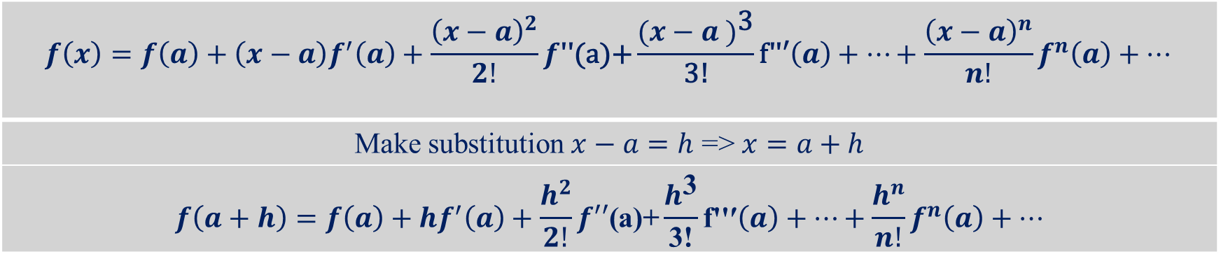

$$f\left(x\right)=f\left(a\right)+\left(x−a\right)f^{′}\left(a\right)+\frac{{\left(x−a\right)}^{2}}{2!}f\text{′′(}\text{a}\text{)+}\frac{{(x−a )}^{\text{3}}}{\text{3}\text{!}}\text{f}\text{′′′}\left(a\right)+…+\frac{{\left(x−a\right)}^{n}}{n!}f^{n}\left(a\right)+…$$
Make substitution $x−a=h$ => $x=a+h$
$$f\left(a+h\right)=f\left(a\right)+hf^{′}\left(a\right)+\frac{h^{2}}{2!}f′′\text{(}\text{a}\text{)+}\frac{h^{\text{3}}}{\text{3}\text{!}}\text{f}\text{′′′}\left(a\right)+…+\frac{h^{n}}{n!}f^{n}\left(a\right)+…$$
Q.3 Using Taylors Theorem, express $5+4{\left(x−1\right)}^{2}−3{\left(x−1\right)}^{3}+{\left(x−1\right)}^{4}$ in ascending powers of x.
$f\left(x−1\right)=5+4{\left(x−1\right)}^{2}−3{\left(x−1\right)}^{3}+{\left(x−1\right)}^{4}$
$f\left(x−1\right)=f\left(x+\left(−1\right)\right)$ => h = x and a = -1.
Use Taylor Series
$f\left(a+h\right)=f\left(a\right)+hf^{′}\left(a\right)+\frac{h^{2}}{2!}f\text{′′}\text{(}\text{a}\text{)+}\frac{h^{\text{3}}}{\text{3!}}\text{f}\text{′′′}\left(a\right)+…+\frac{h^{n}}{n!}f^{n}\left(a\right)+…$
And $f\left(t\right)=5+4t^{2}−3t^{3}+t^{4}$
$f\left(x−1\right)=f\left(−1\right)+xf^{′}\left(−1\right)+\frac{x^{2}}{2!}f^{′′}\left(−1\right)+\frac{x^{3}}{3!}f^{′′′}\left(−1\right)+\frac{x^{4}}{4!}f′′′′(−1)$. → $eq^{n}−1$
Now find the values $f\left(−1\right), f^{′}\left(−1\right), f^{′′}\left(−1\right), f′′′(−1)$ and $f′′′′(−1)$.

Slide 12
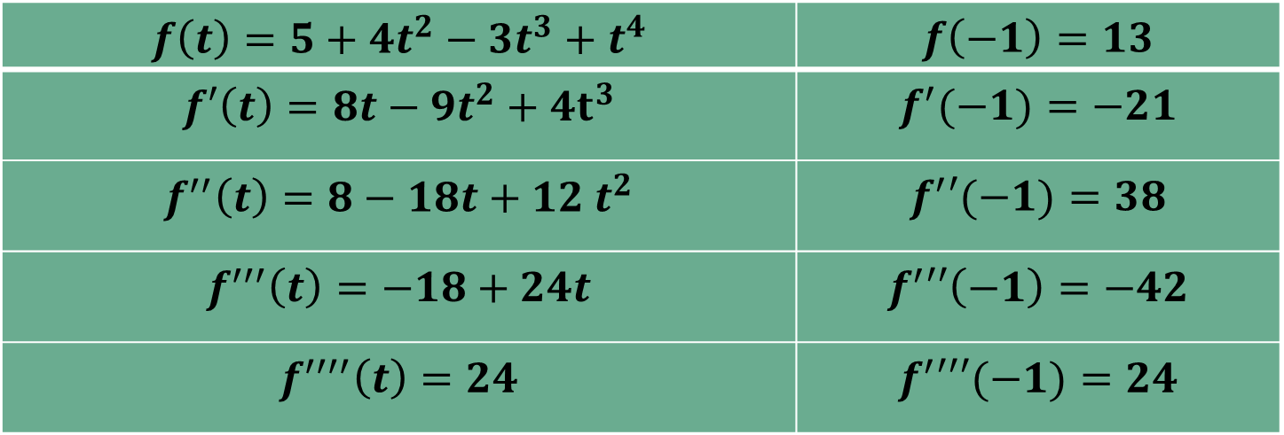
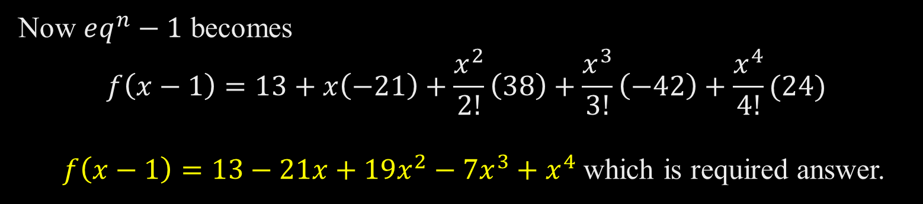
Now $eq^{n}−1$ becomes $$f\left(x−1\right)=13+x\left(−21\right)+\frac{x^{2}}{2!}\left(38\right)+\frac{x^{3}}{3!}\left(−42\right)+\frac{x^{4}}{4!}(24)$$ $f\left(x−1\right)=13−21x+19x^{2}−7x^{3}+x^{4}$ which is required answer.
$$f\left(t\right)=5+4t^{2}−3t^{3}+t^{4}$$ | $$f\left(−1\right)=13$$
$$f′\left(t\right)=8t−9t^{2}+4t^{3}$$ | $$f^{′}(−1)=−21$$
$$f^{′′}\left(t\right)=8−18t+12 t^{2}$$ | $$f^{′}′(−1)=38$$
$$f^{′′′}\left(t\right)=−18+24t$$ | $$f^{′}′′\left(−1\right)=−42$$
$$f^{′′′′}\left(t\right)=24$$ | $$f^{′}′′′(−1)=24$$

Slide 13

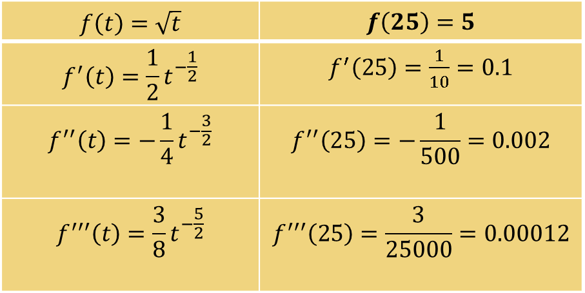
Q.4 Using Taylors Theorem, to find $\sqrt{25.15}$.
$f\left(a+h\right)= \sqrt{a+h}$
By Taylors $Th^{m}$ $f\left(a+h\right)=f\left(a\right)+hf^{′}\left(a\right)+\frac{h^{2}}{2!}f′′\text{(}\text{a}\text{)+}\frac{h^{\text{3}}}{\text{3!}}\text{f}\text{′′′}\left(a\right)+…+\frac{h^{n}}{n!}f^{n}\left(a\right)+…$
put $a+h=t$ => $f\left(t\right)=\sqrt{t}$
Here $\sqrt{25.15}= \sqrt{25+0.15}$
We choose $a=2$ and $h=0.15$
$h^{2}=0.0225$ , $h^{3}=0.003375$
$f\left(a+h\right)= \sqrt{a+h}=\sqrt{25+0.15}$
$$f\left(t\right)=\sqrt{t}$$ | $$f\left(25\right)=5$$
$$f^{′}\left(t\right)=\frac{1}{2}t^{−\frac{1}{2}}$$ | $f^{′}\left(25\right)=\frac{1}{10}=0.1$
$$f^{′′}\left(t\right)=−\frac{1}{4}t^{−\frac{3}{2}}$$ | $$f^{′′}\left(25\right)=−\frac{1}{500}=0.002$$
$$f^{′′′}\left(t\right)=\frac{3}{8}t^{−\frac{5}{2}}$$ | $$f^{′′′}\left(25\right)=\frac{3}{25000}=0.00012$$

Slide 14

$\sqrt{25+0.15}=f\left(25\right)+hf^{′}\left(25\right)+\frac{h^{2}}{2!}f^{′′}\left(25\right)+\frac{h^{3}}{3!}f^{′′′}\left(25\right)+…$
$=5+\left(0.15\right)\left(0.1\right)−\frac{\left(0.0225\right)\left(0.002\right)}{2}+\frac{\left(0.003375\right)\left(0.00012\right)}{6}$
$=5+0.015−0.0000225+0.00000006705$
= 5.014977567
= 5.0149

Slide 15
Thank you

